Slide 1
PHP
Chapter 19: PHP
By: Dr. Qusai Abuein

Slide 2

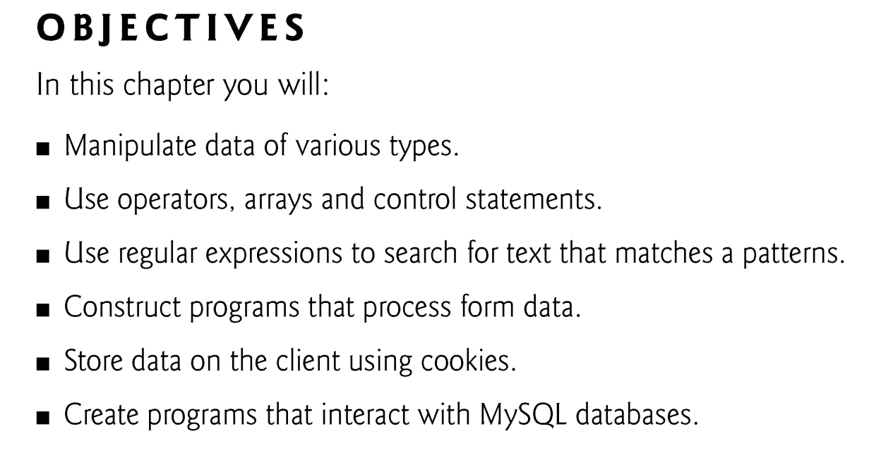
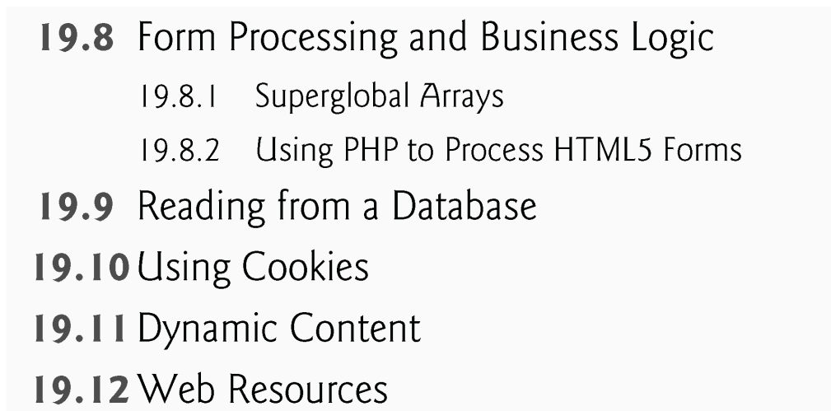

Slide 3
19.9 Reading from a Database
Function mysql_connect connects to the MySQL database. It takes three arguments—
the server’s hostname
a username
a password
and returns a database handle—a representation of PHP’s connection to the database, or false if the connection fails.

Slide 4
1- Opening Database Connection:
$Conn = mysql_connect(server, user ,password);
Parameter | Description
server | Optional - The host name running database server. If not specified then default value is localhost
user | Optional - The username accessing the database. If not specified then default is the name of the user that owns the server process.
passwd | Optional - The password of the user accessing the database. If not specified then default is an empty password.

Slide 5
2 - Selecting a Database
Once you establish a connection with a database server then it is required to select a particular database where your all the tables are associated.
PHP provides function mysql_select_db to select a database. It returns TRUE on success or FALSE on failure.
bool mysql_select_db( db_name, connection );
Parameter | Description
db_name | Required - Database name to be selected
connection | Optional - if not specified then last opend connection by mysql_connect will be used.

Slide 6
<?php $dbhost = 'localhost'; $dbuser = ‘root'; $dbpass = ‘asd12345'; $conn = mysql_connect($dbhost, $dbuser, $dbpass); if(! $conn ) { die('Could not connect: ' . mysql_error()); } echo 'Connected successfully'; mysql_select_db( ‘library' ); mysql_close($conn); ?>

Slide 7
3 – Execute a Query
bool mysql_query( sql, connection );
Parameter | Description
sql | Required - SQL query to execute
connection | Optional - if not specified then last opend connection by mysql_connect will be used.
bool mysql_query( sql, connection );

Slide 8
Queries types
Create a database
$sql = 'CREATE Database test_db';
Creating Database Tables:
sql = 'CREATE TABLE employee( '.
'emp_id INT NOT NULL AUTO_INCREMENT, '.
'emp_name VARCHAR(20) NOT NULL, '.
'emp_address VARCHAR(20) NOT NULL, '.
'emp_salary INT NOT NULL, '.
'join_date timestamp(14) NOT NULL, '.
'primary key ( emp_id ))';
$retval = mysql_query( $sql, $conn );

Slide 9
Insert Data into MySQL Database
$sql = "INSERT INTO employee ".
"(emp_name,emp_address, emp_salary, join_date) ".
"VALUES('$emp_name','$emp_address',$emp_salary, NOW())";
$retval = mysql_query( $sql, $conn );
Deleting Data from MySQL Database
$sql = "DELETE employee ".
"WHERE emp_id = $emp_id" ;
$retval = mysql_query( $sql, $conn );
Updating Data into MySQL Database
$sql = "UPDATE employee ".
"SET emp_salary = $emp_salary ".
"WHERE emp_id = $emp_id" ;
$retval = mysql_query( $sql, $conn );

Slide 10
4- Getting Data From MySQL Database
<?php $result = mysql_query("SELECT id,email FROM people WHERE id = '42'"); if (!$result) { echo 'Could not run query: ' . mysql_error(); exit; } $row = mysql_fetch_row($result); echo $row[0]; // 42 echo $row[1]; // the email value ?>

Slide 11
$result = mysql_query($sql2,$Conn);
while ($row = mysql_fetch_row($result))
{
foreach ($row as $key => $value )
print $value."<br>";
}

Slide 12
5-Closing Database Connection:
bool mysql_close ($link_identifier );

Slide 13
19.9 Reading from a Database (Cont.)
To query the database, we call function mysql_query, specifying the query string and the database to query.
This returns a resource containing the result of the query, or false if the query fails.
It can also execute SQL statements such as INSERT or DELETE that do not return results.
The mysql_error function returns any error strings from the database.
mysql_close closes the connection to the database specified in its argument.
The mysql_fetch_row function returns an array containing the values for each column in the current row of the query result ($result).

Slide 14
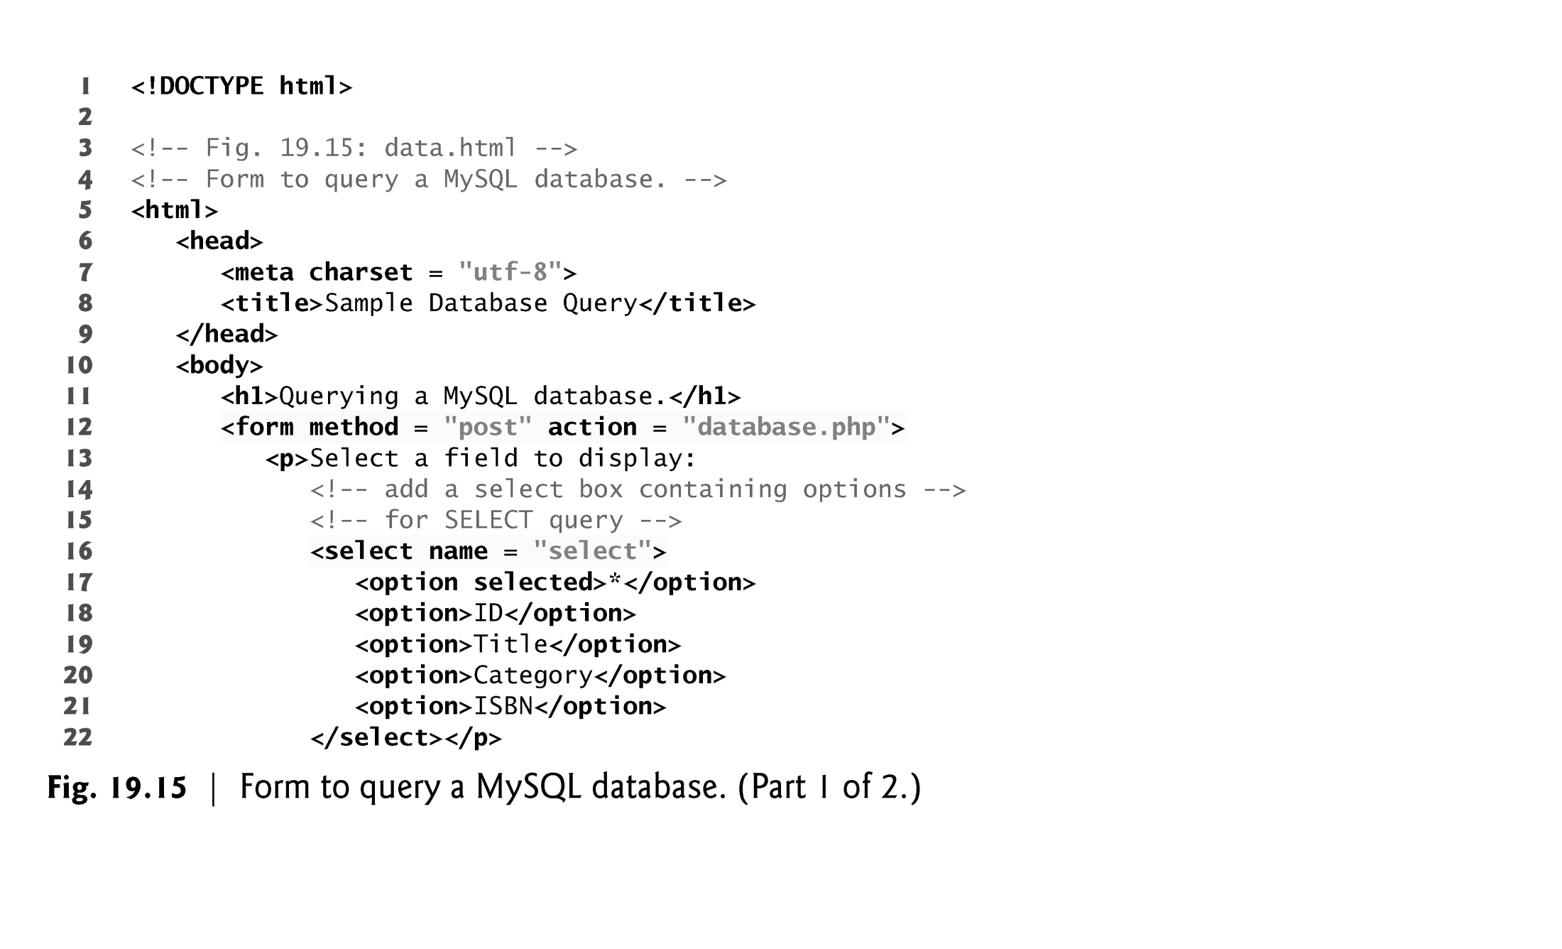

Slide 15
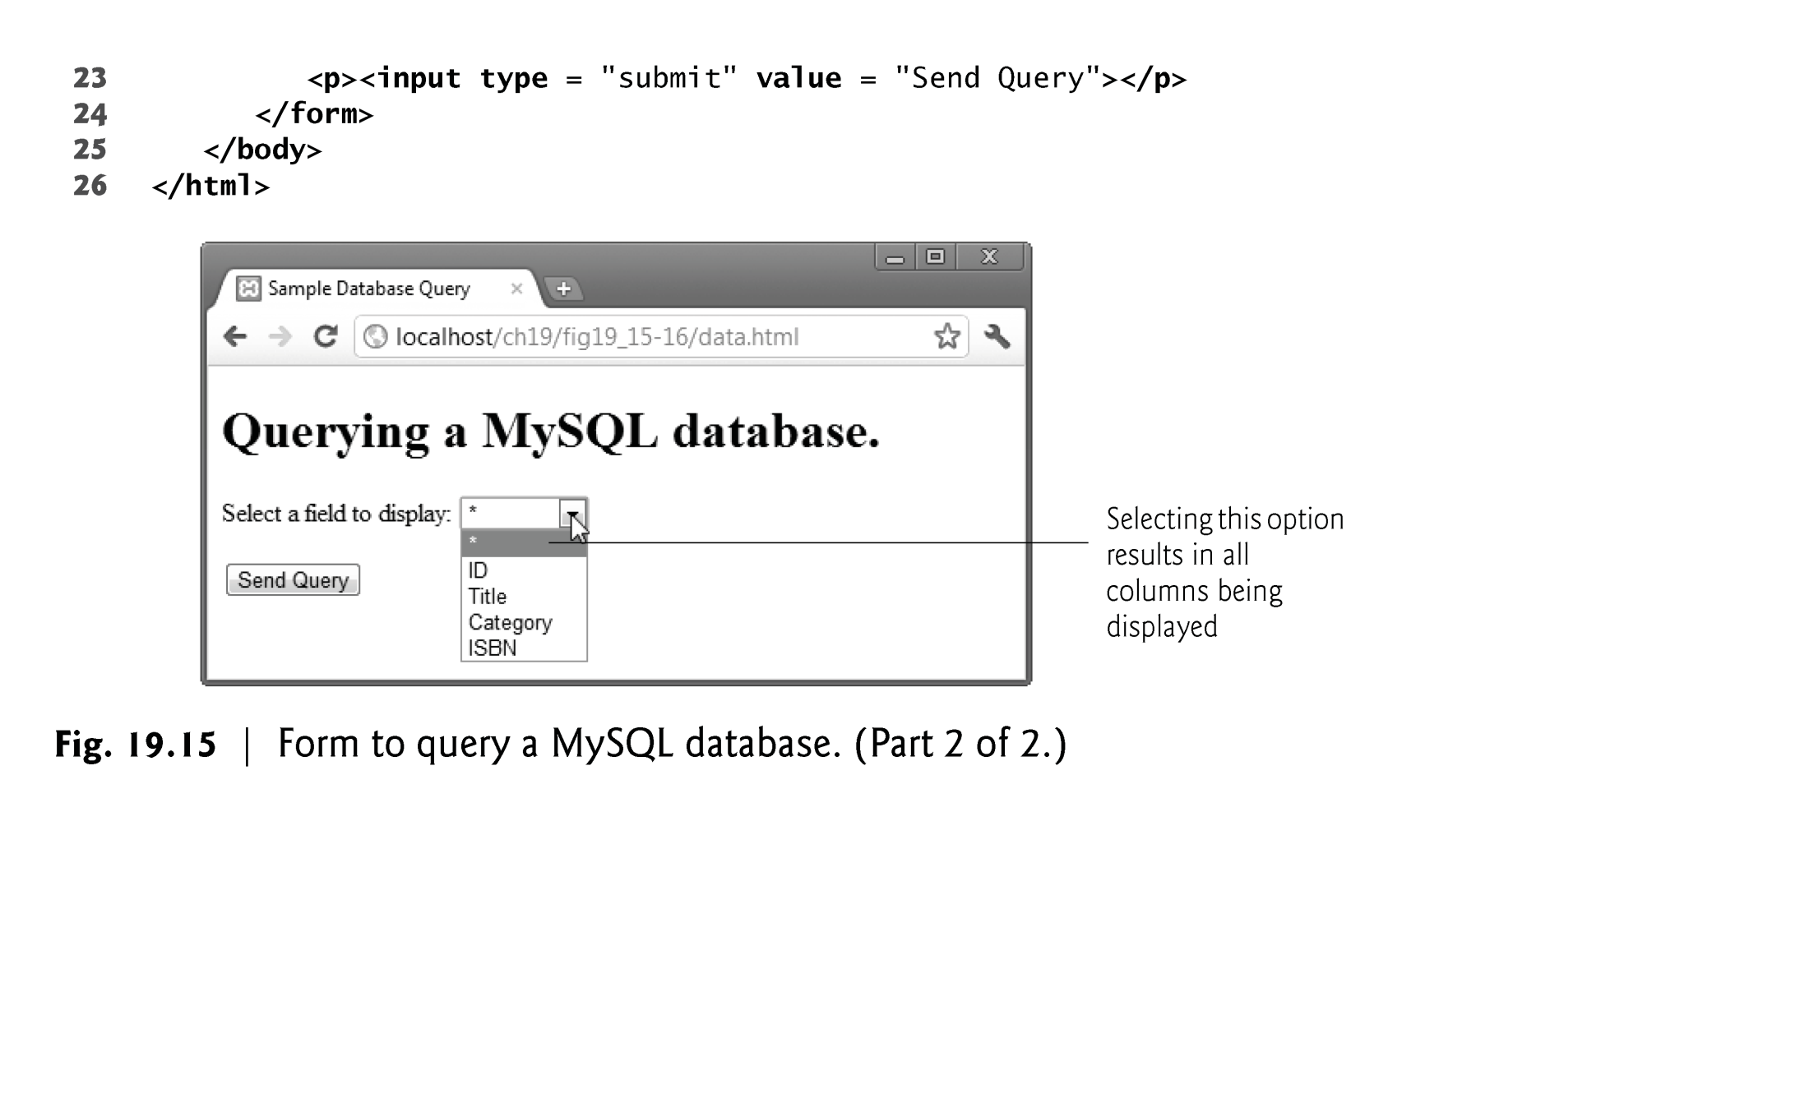

Slide 16
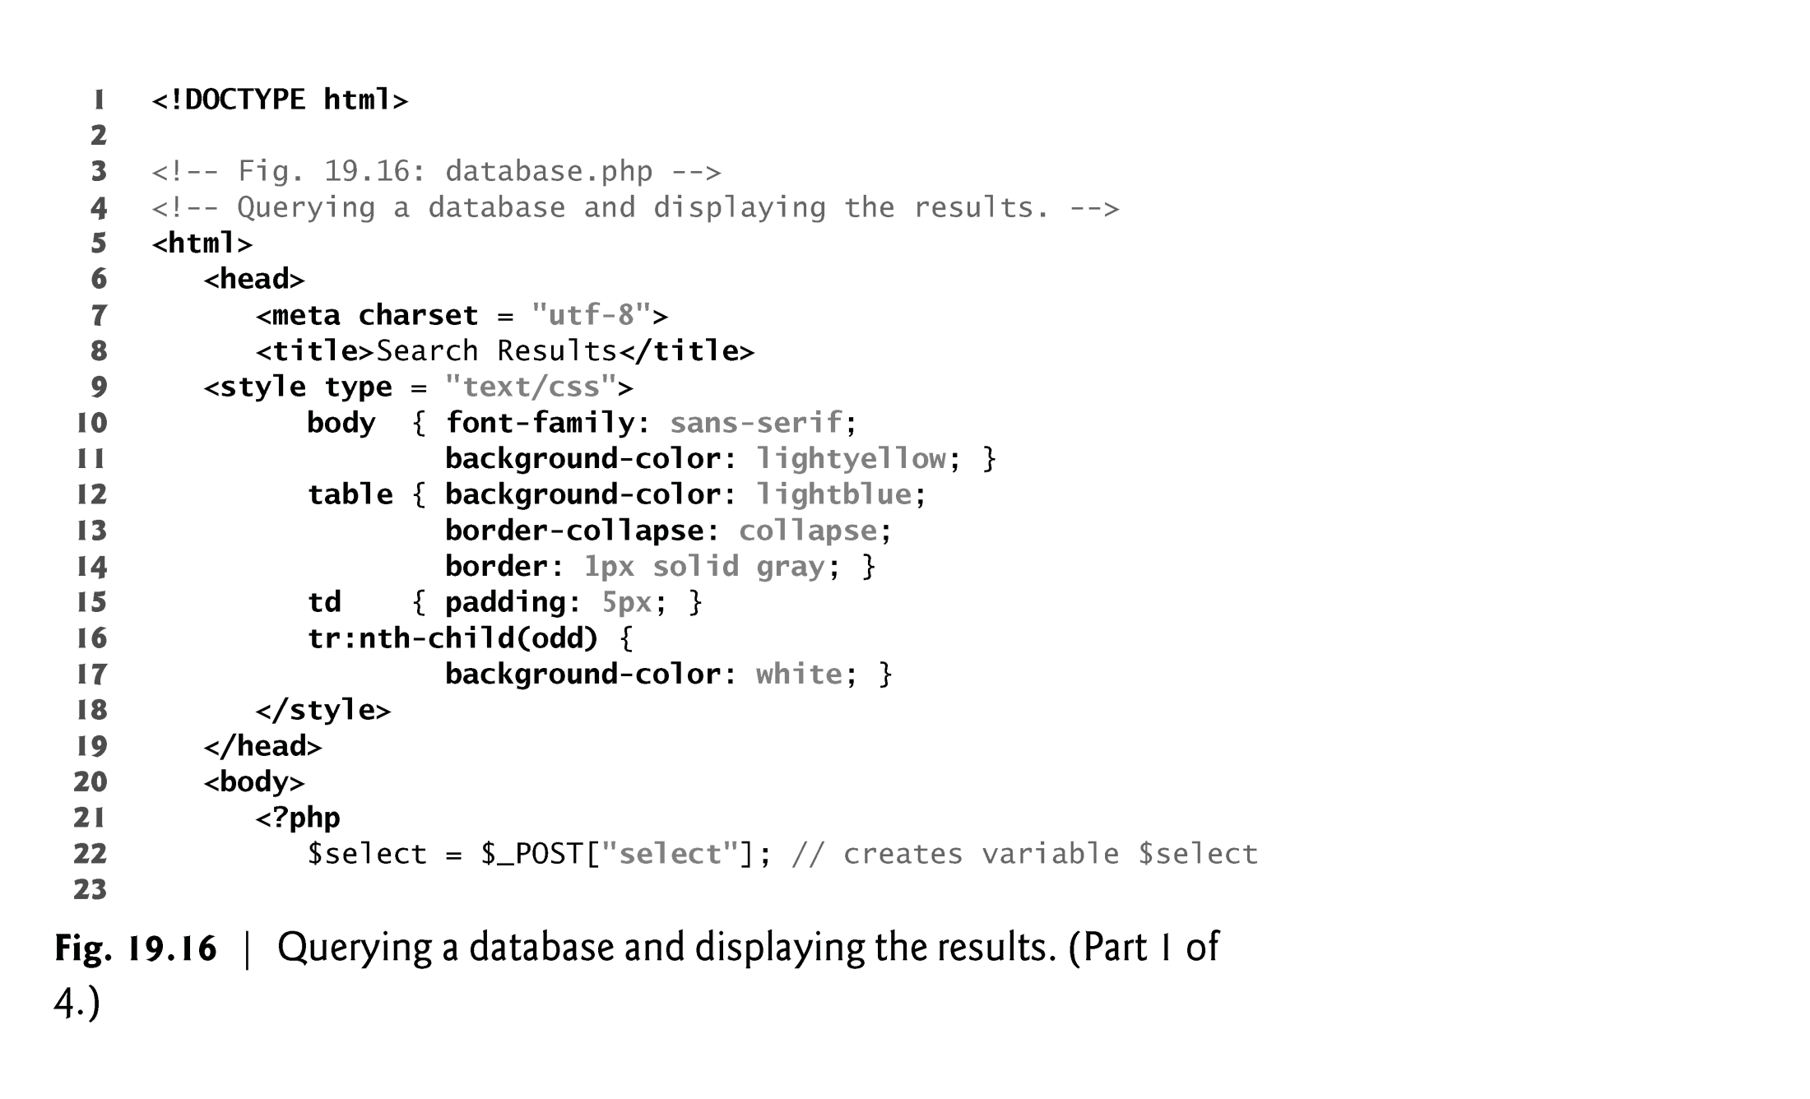

Slide 17
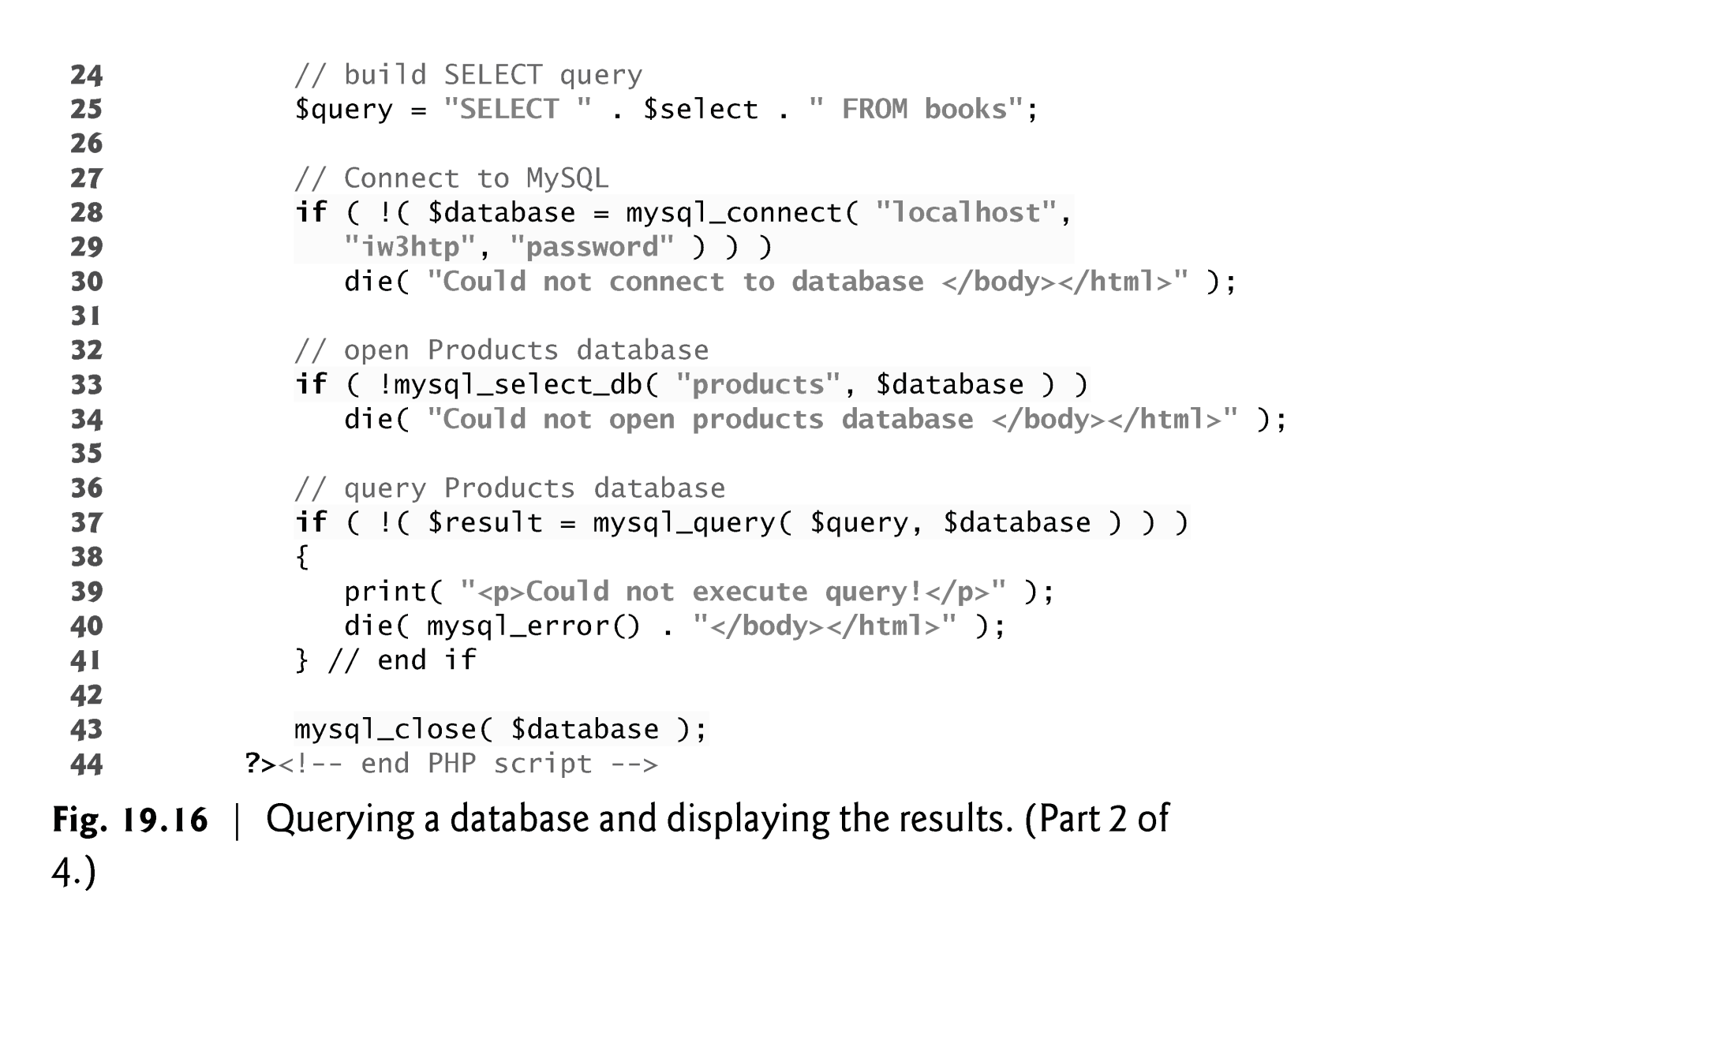

Slide 18
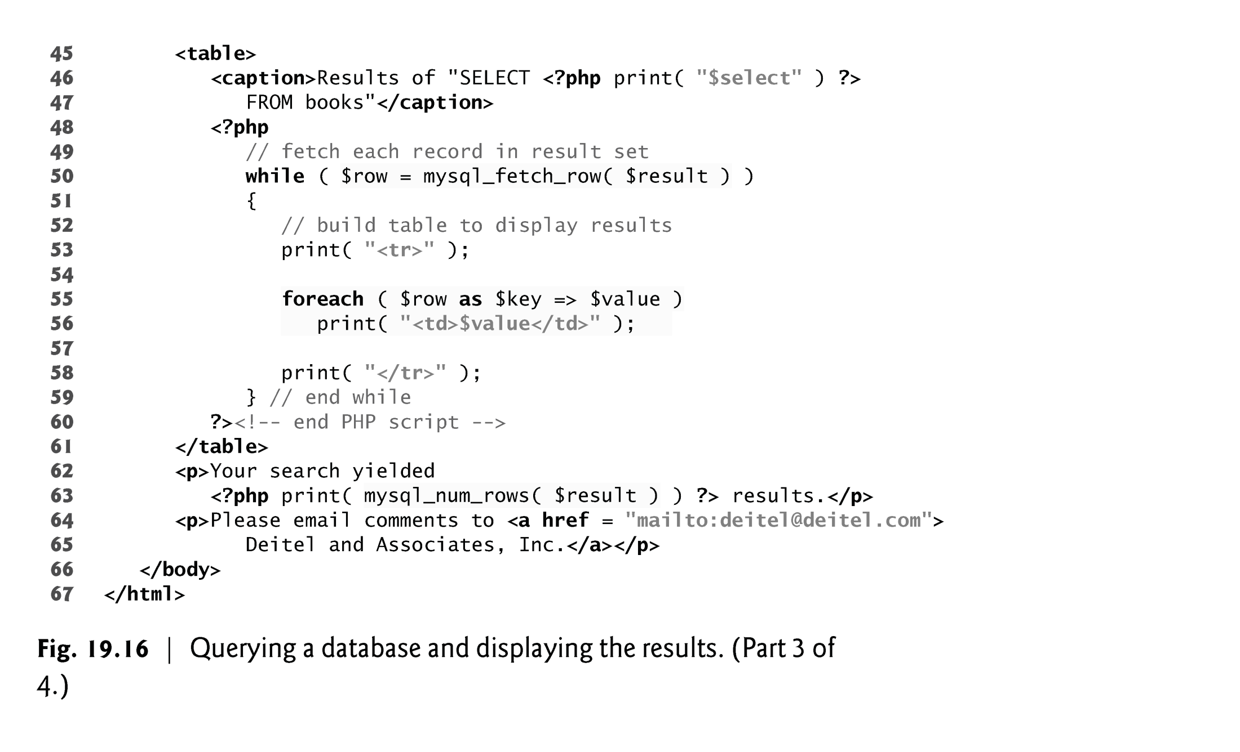

Slide 19
